Slide 1
Chapter 5
Database Design 1:
Some Normalization Examples
Spring 2006

Slide 2
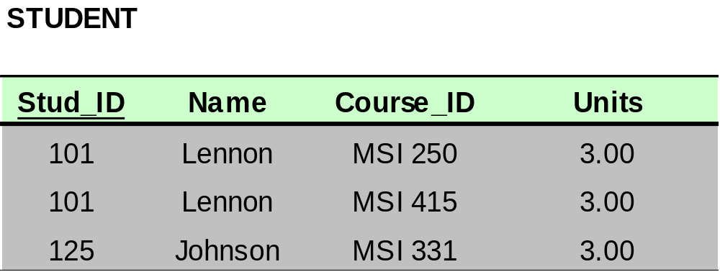
Dependencies: Definitions
Multivalued Attributes (or repeating groups): non-key attributes or groups of non-key attributes the values of which are not uniquely identified by (directly or indirectly) (not functionally dependent on) the value of the Primary Key (or its part).

Slide 3

Dependencies: Definitions
Partial Dependency – when an non-key attribute is determined by a part, but not the whole, of a COMPOSITE primary key.
Partial Dependency

Slide 4
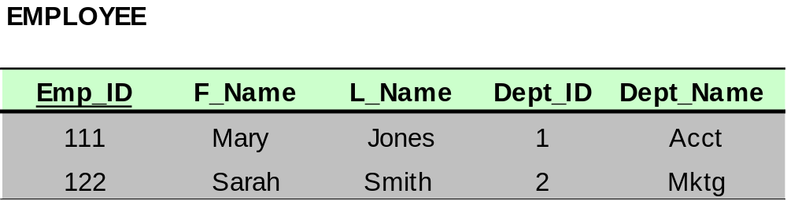
Dependencies: Definitions
Transitive Dependency – when a non-key attribute determines another non-key attribute.
Transitive Dependency

Slide 5
Normal Forms: Review
Unnormalized – There are multivalued attributes or repeating groups
1 NF – No multivalued attributes or repeating groups.
2 NF – 1 NF plus no partial dependencies
3 NF – 2 NF plus no transitive dependencies

Slide 6

Example 1: Determine NF
All attributes are directly or indirectly determined by the primary key; therefore, the relation is at least in 1 NF
ISBN → Title
ISBN → Publisher
Publisher → Address

Slide 7
Example 1: Determine NF
The relation is at least in 1NF. There is no COMPOSITE primary key, therefore there can’t be partial dependencies. Therefore, the relation is at least in 2NF
ISBN → Title
ISBN → Publisher
Publisher → Address

Slide 8
Example 1: Determine NF
Publisher is a non-key attribute, and it determines Address, another non-key attribute. Therefore, there is a transitive dependency, which means that the relation is NOT in 3 NF.
ISBN → Title
ISBN → Publisher
Publisher → Address

Slide 9
Example 1: Determine NF
We know that the relation is at least in 2NF, and it is not in 3 NF. Therefore, we conclude that the relation is in 2NF.
ISBN → Title
ISBN → Publisher
Publisher → Address

Slide 10
Example 1: Determine NF
In your solution you will write the following justification:
No M/V attributes, therefore at least 1NF
No partial dependencies, therefore at least 2NF
There is a transitive dependency (Publisher → Address), therefore, not 3NF
Conclusion: The relation is in 2NF
ISBN → Title
ISBN → Publisher
Publisher → Address

Slide 11

Example 2: Determine NF
Product_ID → Description
All attributes are directly or indirectly determined by the primary key; therefore, the relation is at least in 1 NF

Slide 12
Example 2: Determine NF
Product_ID → Description
The relation is at least in 1NF.
There is a COMPOSITE Primary Key (PK) (Order_No, Product_ID), therefore there can be partial dependencies. Product_ID, which is a part of PK, determines Description; hence, there is a partial dependency. Therefore, the relation is not 2NF. No sense to check for transitive dependencies!

Slide 13
Example 2: Determine NF
Product_ID → Description
We know that the relation is at least in 1NF, and it is not in 2 NF. Therefore, we conclude that the relation is in 1 NF.

Slide 14
Example 2: Determine NF
Product_ID → Description
In your solution you will write the following justification:
1) No M/V attributes, therefore at least 1NF
2) There is a partial dependency (Product_ID → Description), therefore not in 2NF
Conclusion: The relation is in 1NF

Slide 15
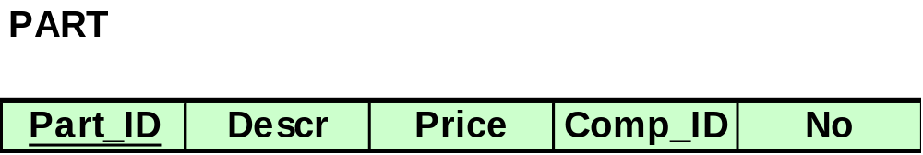
Example 3: Determine NF
Comp_ID and No are not determined by the primary key; therefore, the relation is NOT in 1 NF. No sense in looking at partial or transitive dependencies.
Part_ID → Description
Part_ID → Price
Part_ID, Comp_ID → No

Slide 16
Example 3: Determine NF
In your solution you will write the following justification:
There are M/V attributes; therefore, not 1NF
Conclusion: The relation is not normalized.
Part_ID → Description
Part_ID → Price
Part_ID, Comp_ID → No

Slide 17

Bringing a Relation to 1NF

Slide 18
Bringing a Relation to 1NF
Option 1: Make a determinant of the repeating group (or the multivalued attribute) a part of the primary key.
Composite Primary Key

Slide 19

Bringing a Relation to 1NF
Option 2: Remove the entire repeating group from the relation. Create another relation which would contain all the attributes of the repeating group, plus the primary key from the first relation. In this new relation, the primary key from the original relation and the determinant of the repeating group will comprise a primary key.

Slide 20
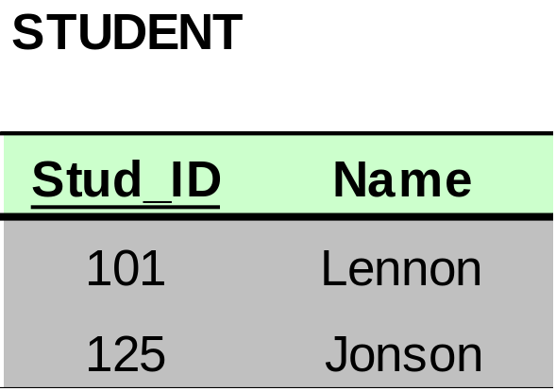
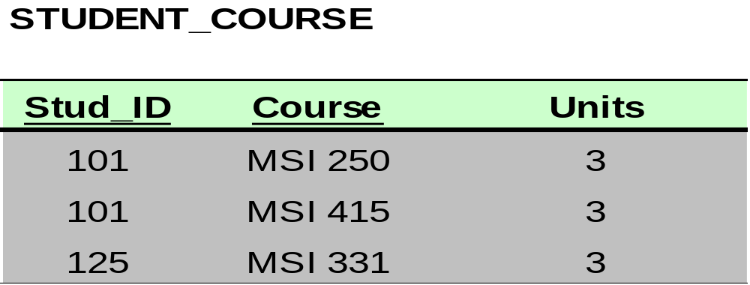
Bringing a Relation to 1NF

Slide 21
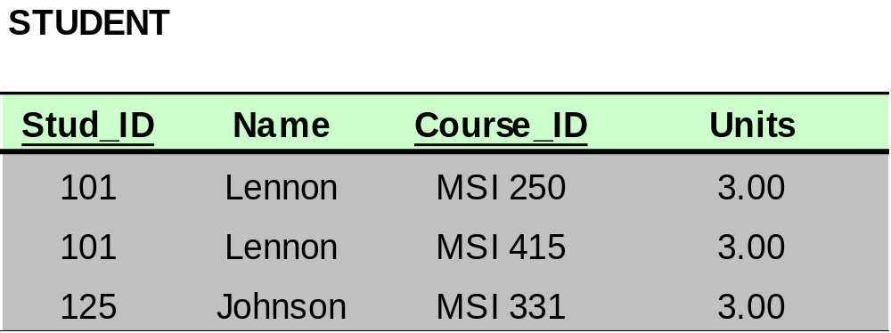
Bringing a Relation to 2NF
Composite Primary Key

Slide 22
Bringing a Relation to 2NF
Goal: Remove Partial Dependencies
Partial Dependencies
Composite Primary Key

Slide 23
Bringing a Relation to 2NF
Remove attributes that are dependent from the part but not the whole of the primary key from the original relation. For each partial dependency, create a new relation, with the corresponding part of the primary key from the original as the primary key.

Slide 24
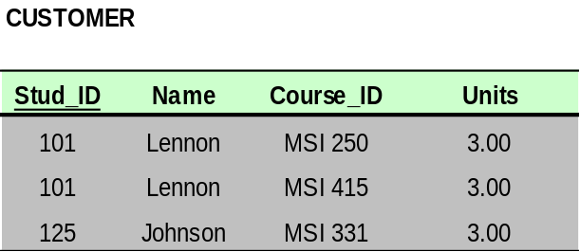

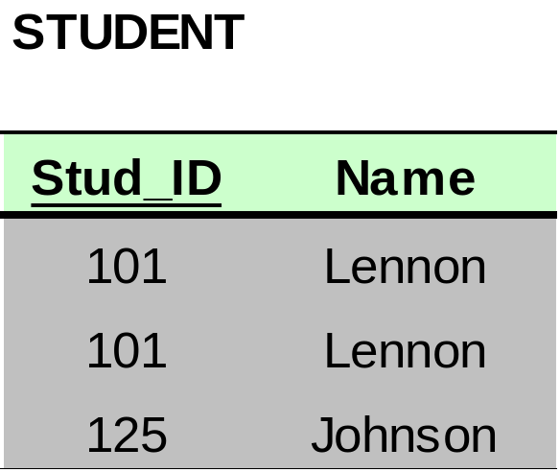
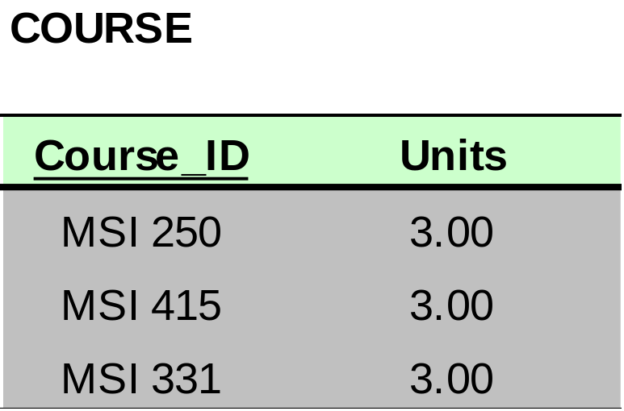
Bringing a Relation to 2NF

Slide 25
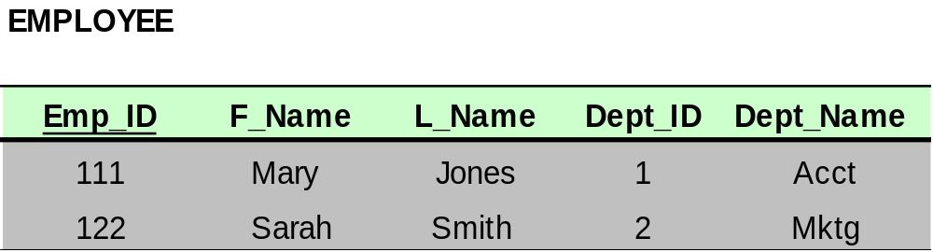
Bringing a Relation to 3NF
Goal: Get rid of transitive dependencies.
Transitive Dependency

Slide 26
Bringing a Relation to 3NF
Remove the attributes, which are dependent on a non-key attribute, from the original relation. For each transitive dependency, create a new relation with the non-key attribute which is a determinant in the transitive dependency as a primary key, and the dependent non-key attribute as a dependent.

Slide 27
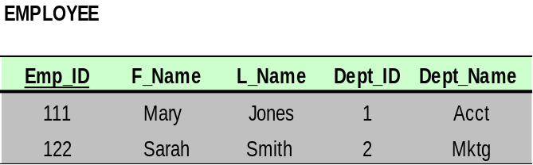
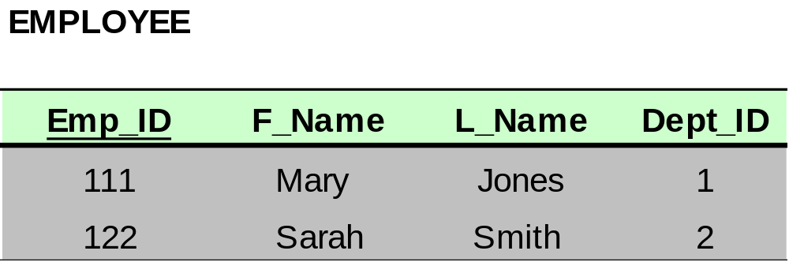
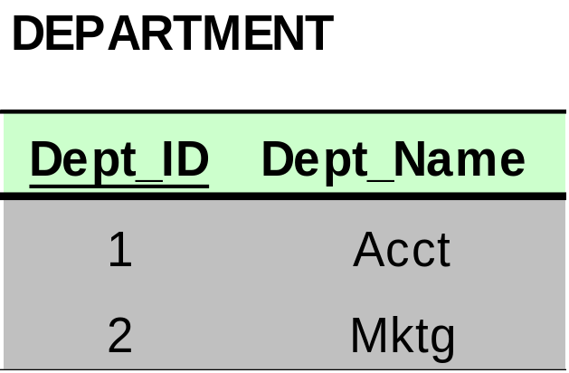
Bringing a Relation to 3NF

